Slide 1
Video game addiction
Needfinding

Slide 2
Activity examined
Video game addiction in different age brackets

Slide 3
Examine methods used
Observing the selected participants in different age brackets while they are spending too much time with what they are playing
Interviewing a willing participant who wanted to share his experience with video game addiction and finding a way to fix it but he wanted to stay anonymous.

Slide 4
insights
user does not know when to stop playing video games.
they lose track of time.
isolate themselves from others in order to spend more time gaming.
Study: 75% Of Kids Under Age 8 Use Mobile

Slide 5
Unmet needs
Gamer need to set up a plan which stops you from buying video games.
Gamer need to limit weekly video game time each day.
Need to be more social outside of the game because it will help you reduce playing time.
Gamer need to find other enjoyment outside of video game.
Gamer need a way to focus on his obligation from school, work,etc because video games
are a major distraction.
Gamer need a way to play less video games because it will cause bad health.
Gamer need a way to stop lying to people about how much time you spend playing.
Gamer need to find a way to keep phones and other
gadgets out of the bedroom so he won’t play into the night.
Gamer need a way to rage less while playing video games because it creates bad behavior.
Gamer need to find a way to share his own gadgets to others because he must be happy.

Slide 6
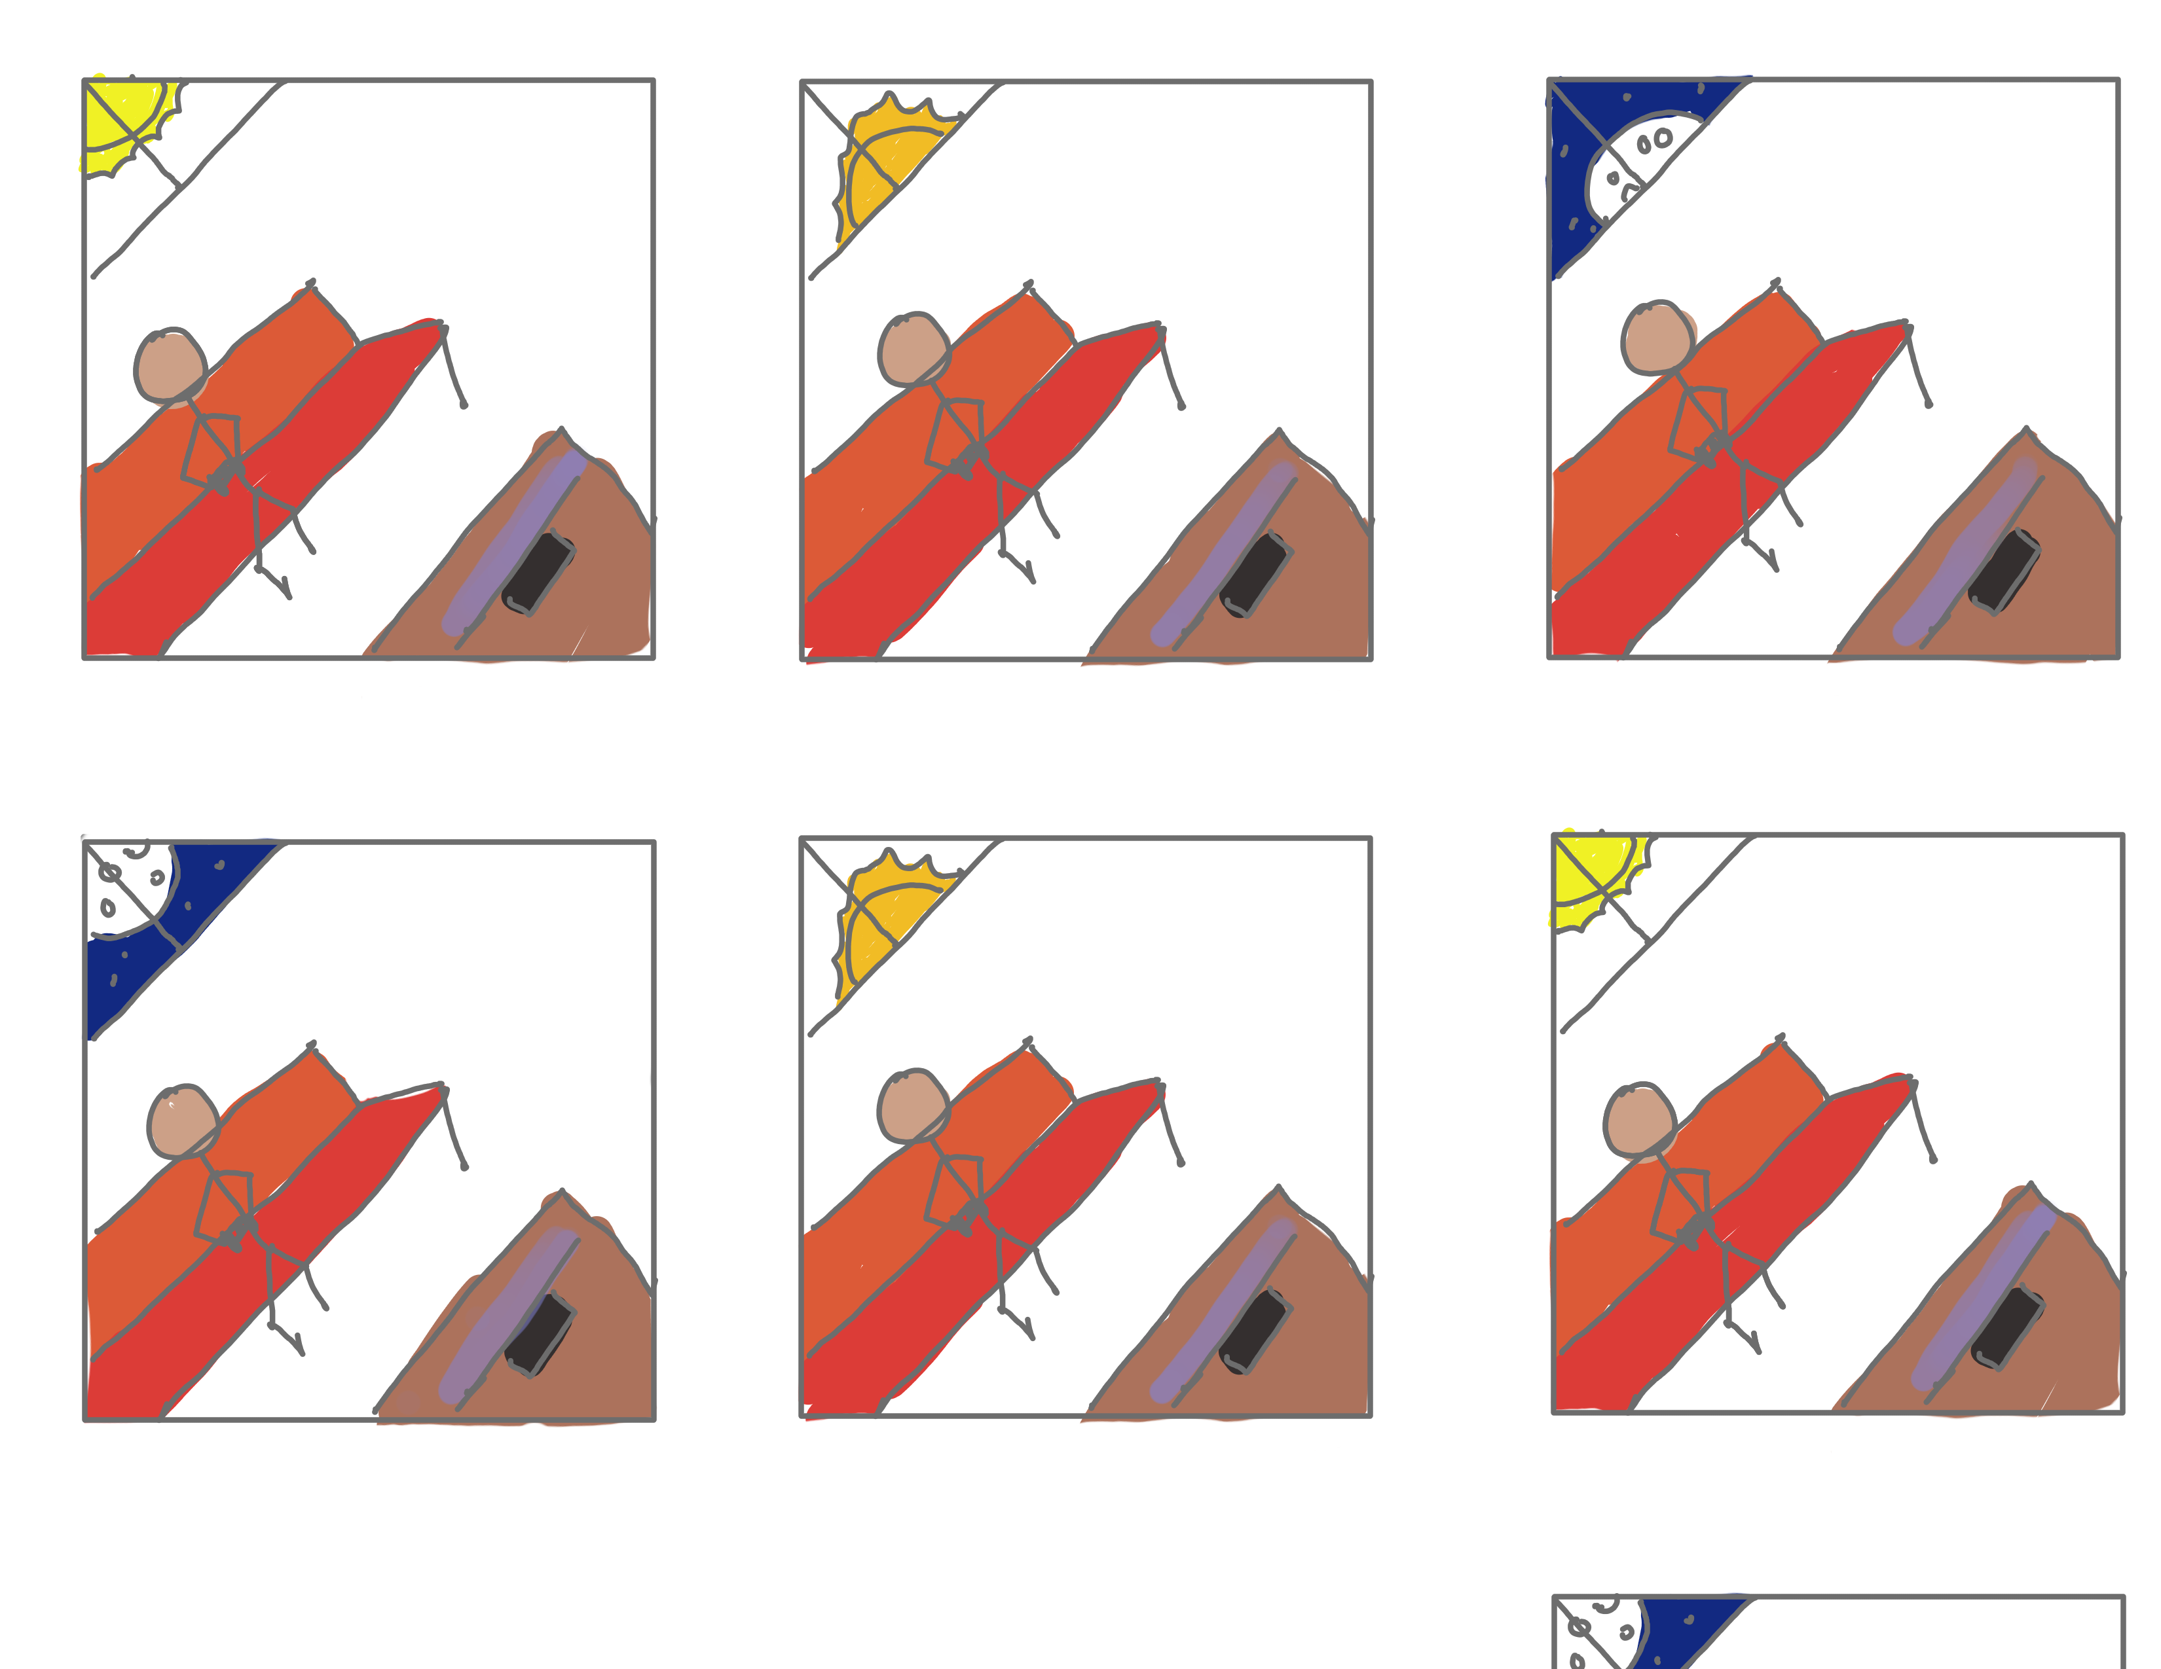
Story board
Up(LtoR)
User starts playing.
User continue to play till sun sets.
User continue to play till evening.
Down(LtoR)
User continue to play till midnight.
User continue to play till dawn.
User doesn’t have sleep and continue to play till morning

Slide 7
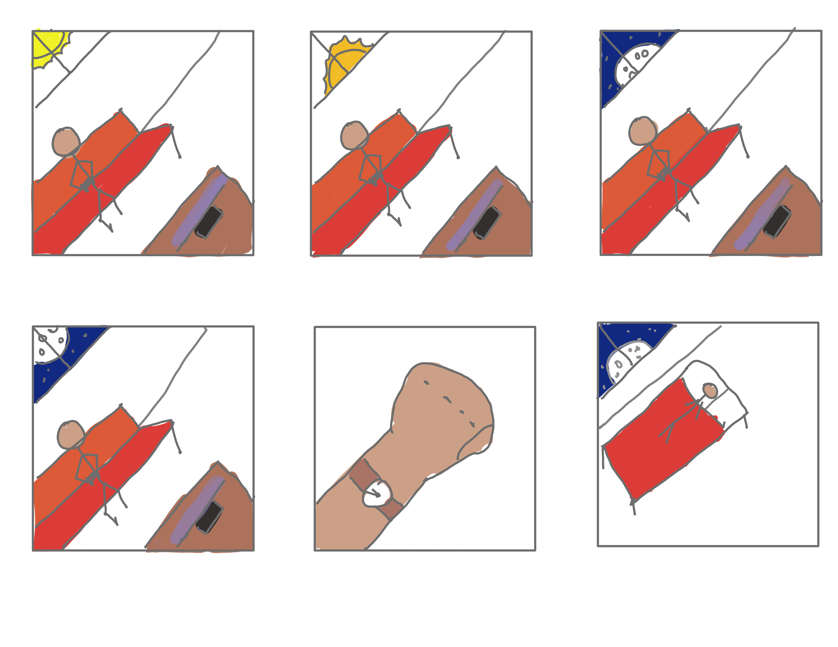
Story board
Up(LtoR)
User starts playing.
User continue to play till sun sets.
User continue to play till evening.
Down(LtoR)
User continue to play till midnight.
User feels sleep and checks time.
User decide to sleeps.

Slide 8
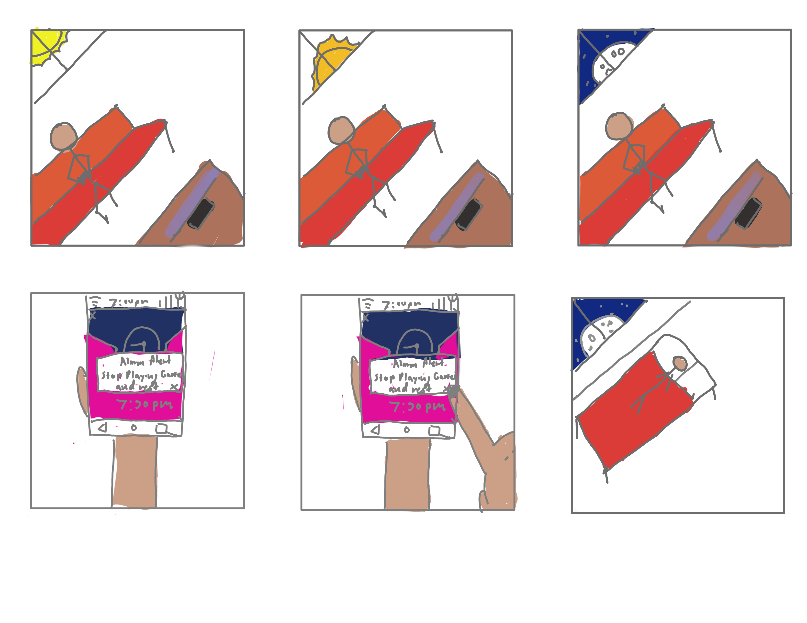
Story board
Up(LtoR)
User starts playing.
User continue to play till sun sets.
User Continue to play till 7:30 pm.
Down(LtoR)
Alarms the user to stop playing and rest.
User taps the alarm exit to restart the alarm the next day.
User sleeps.

Slide 9
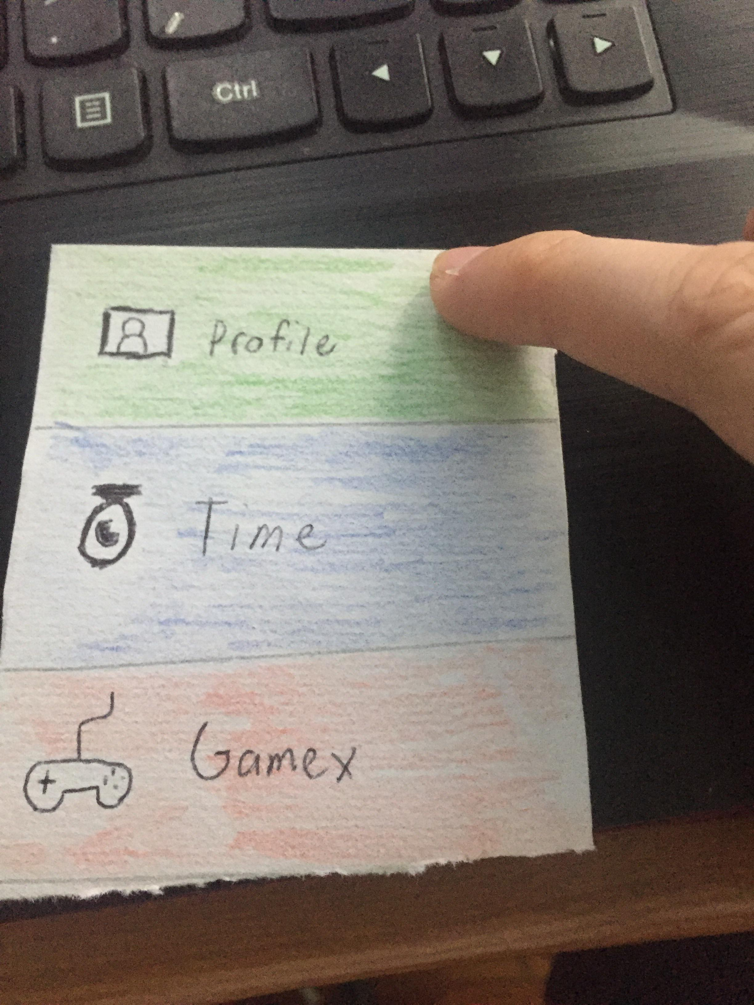
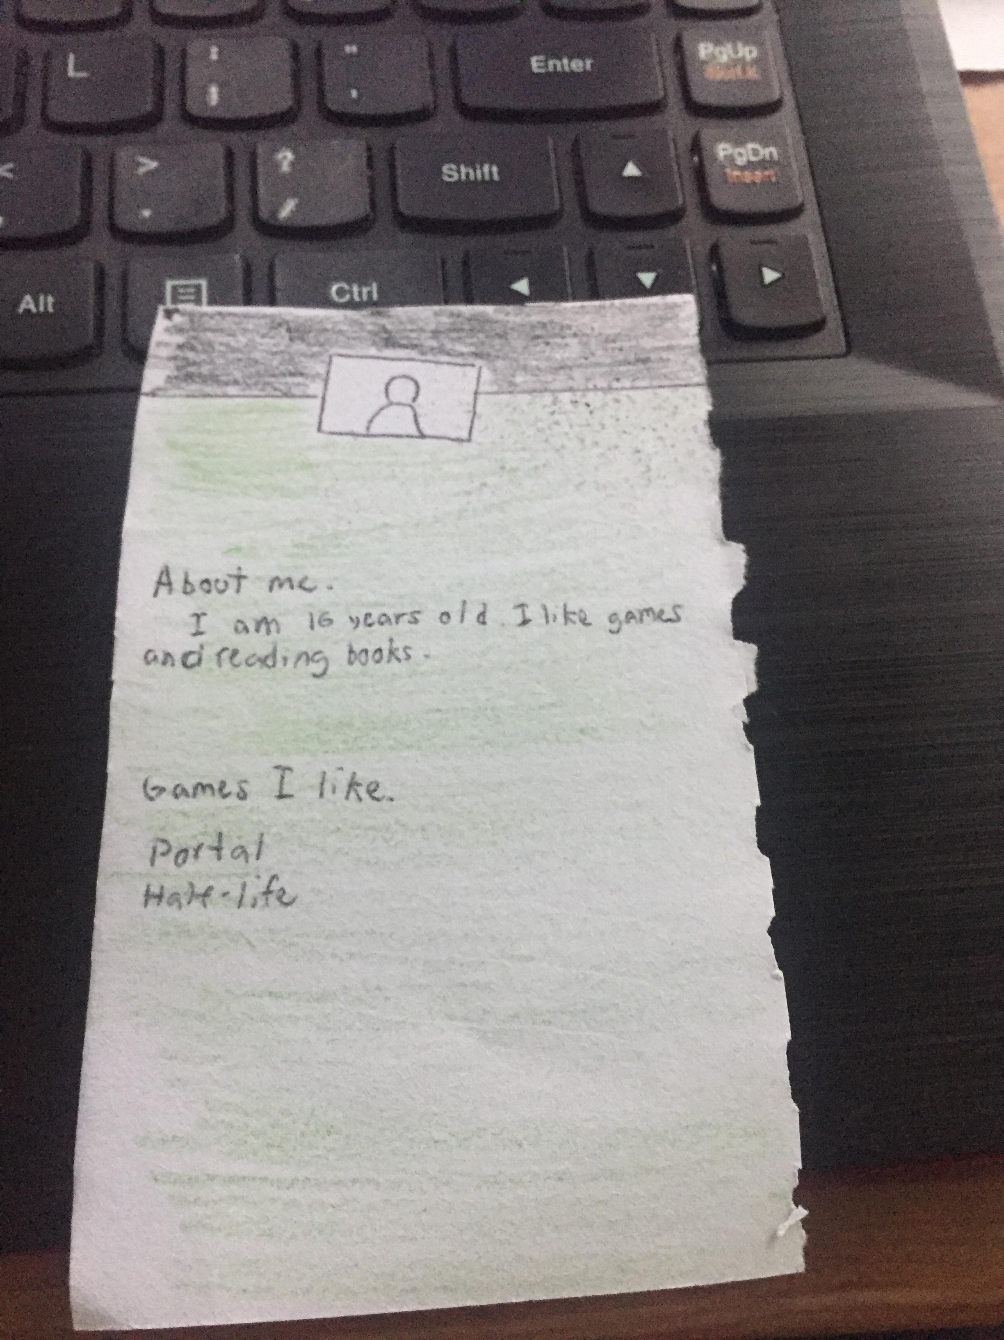
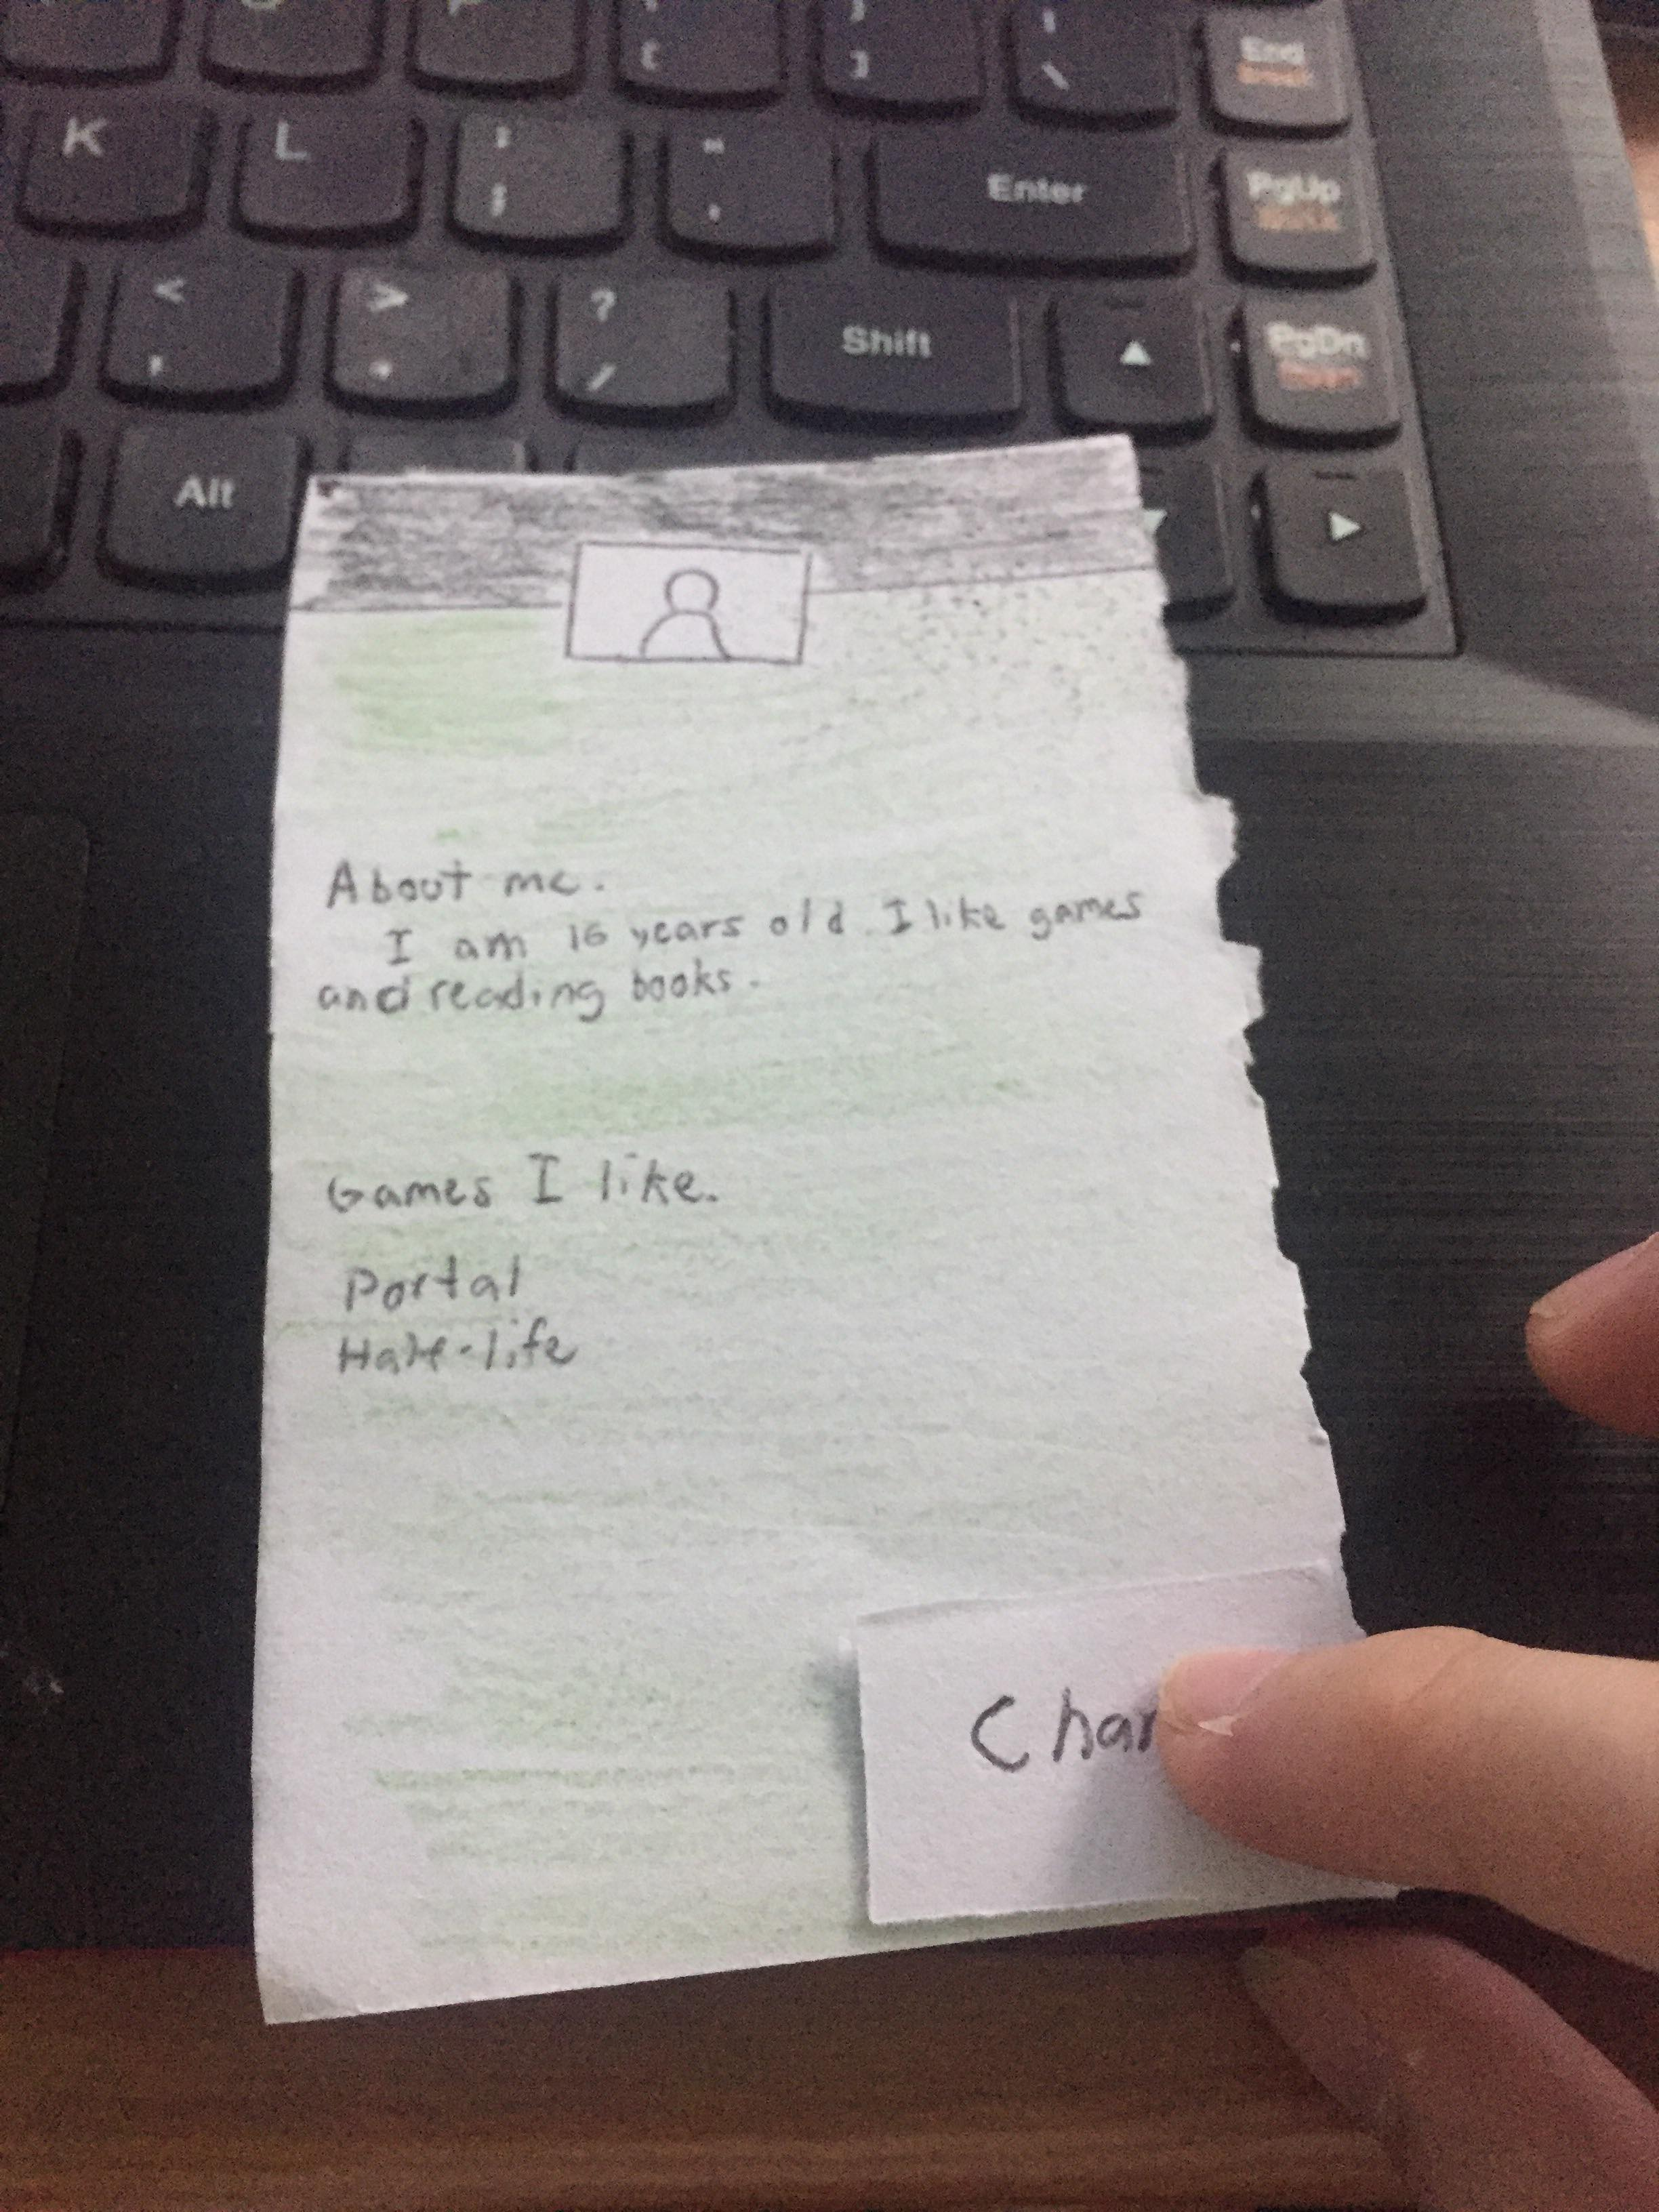
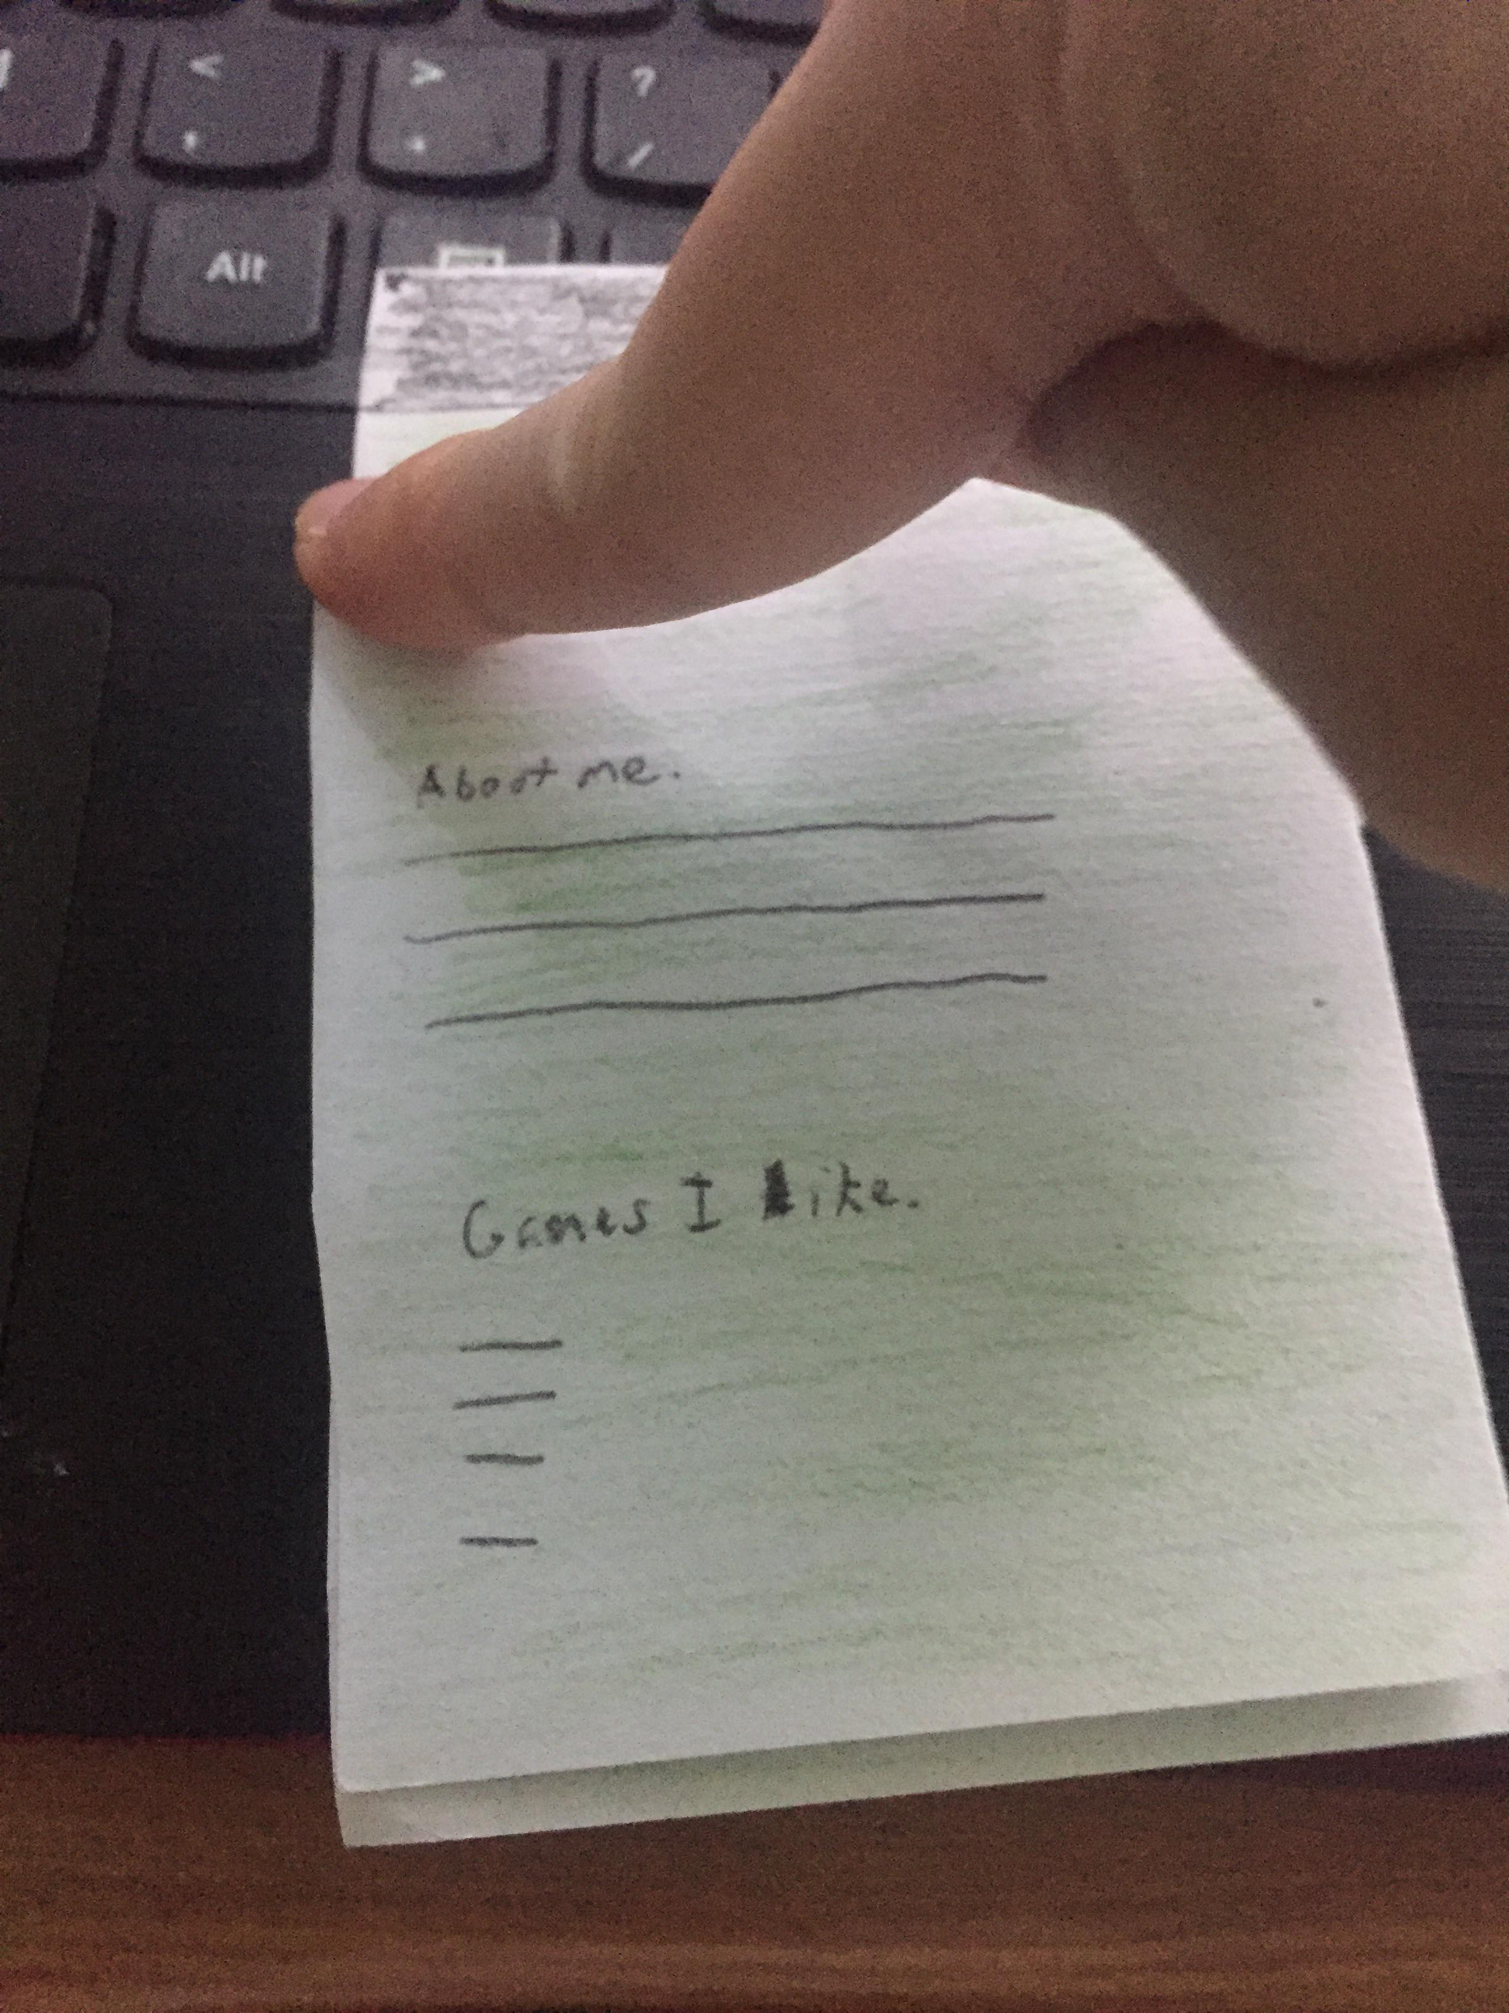
Paper Prototype

Slide 10
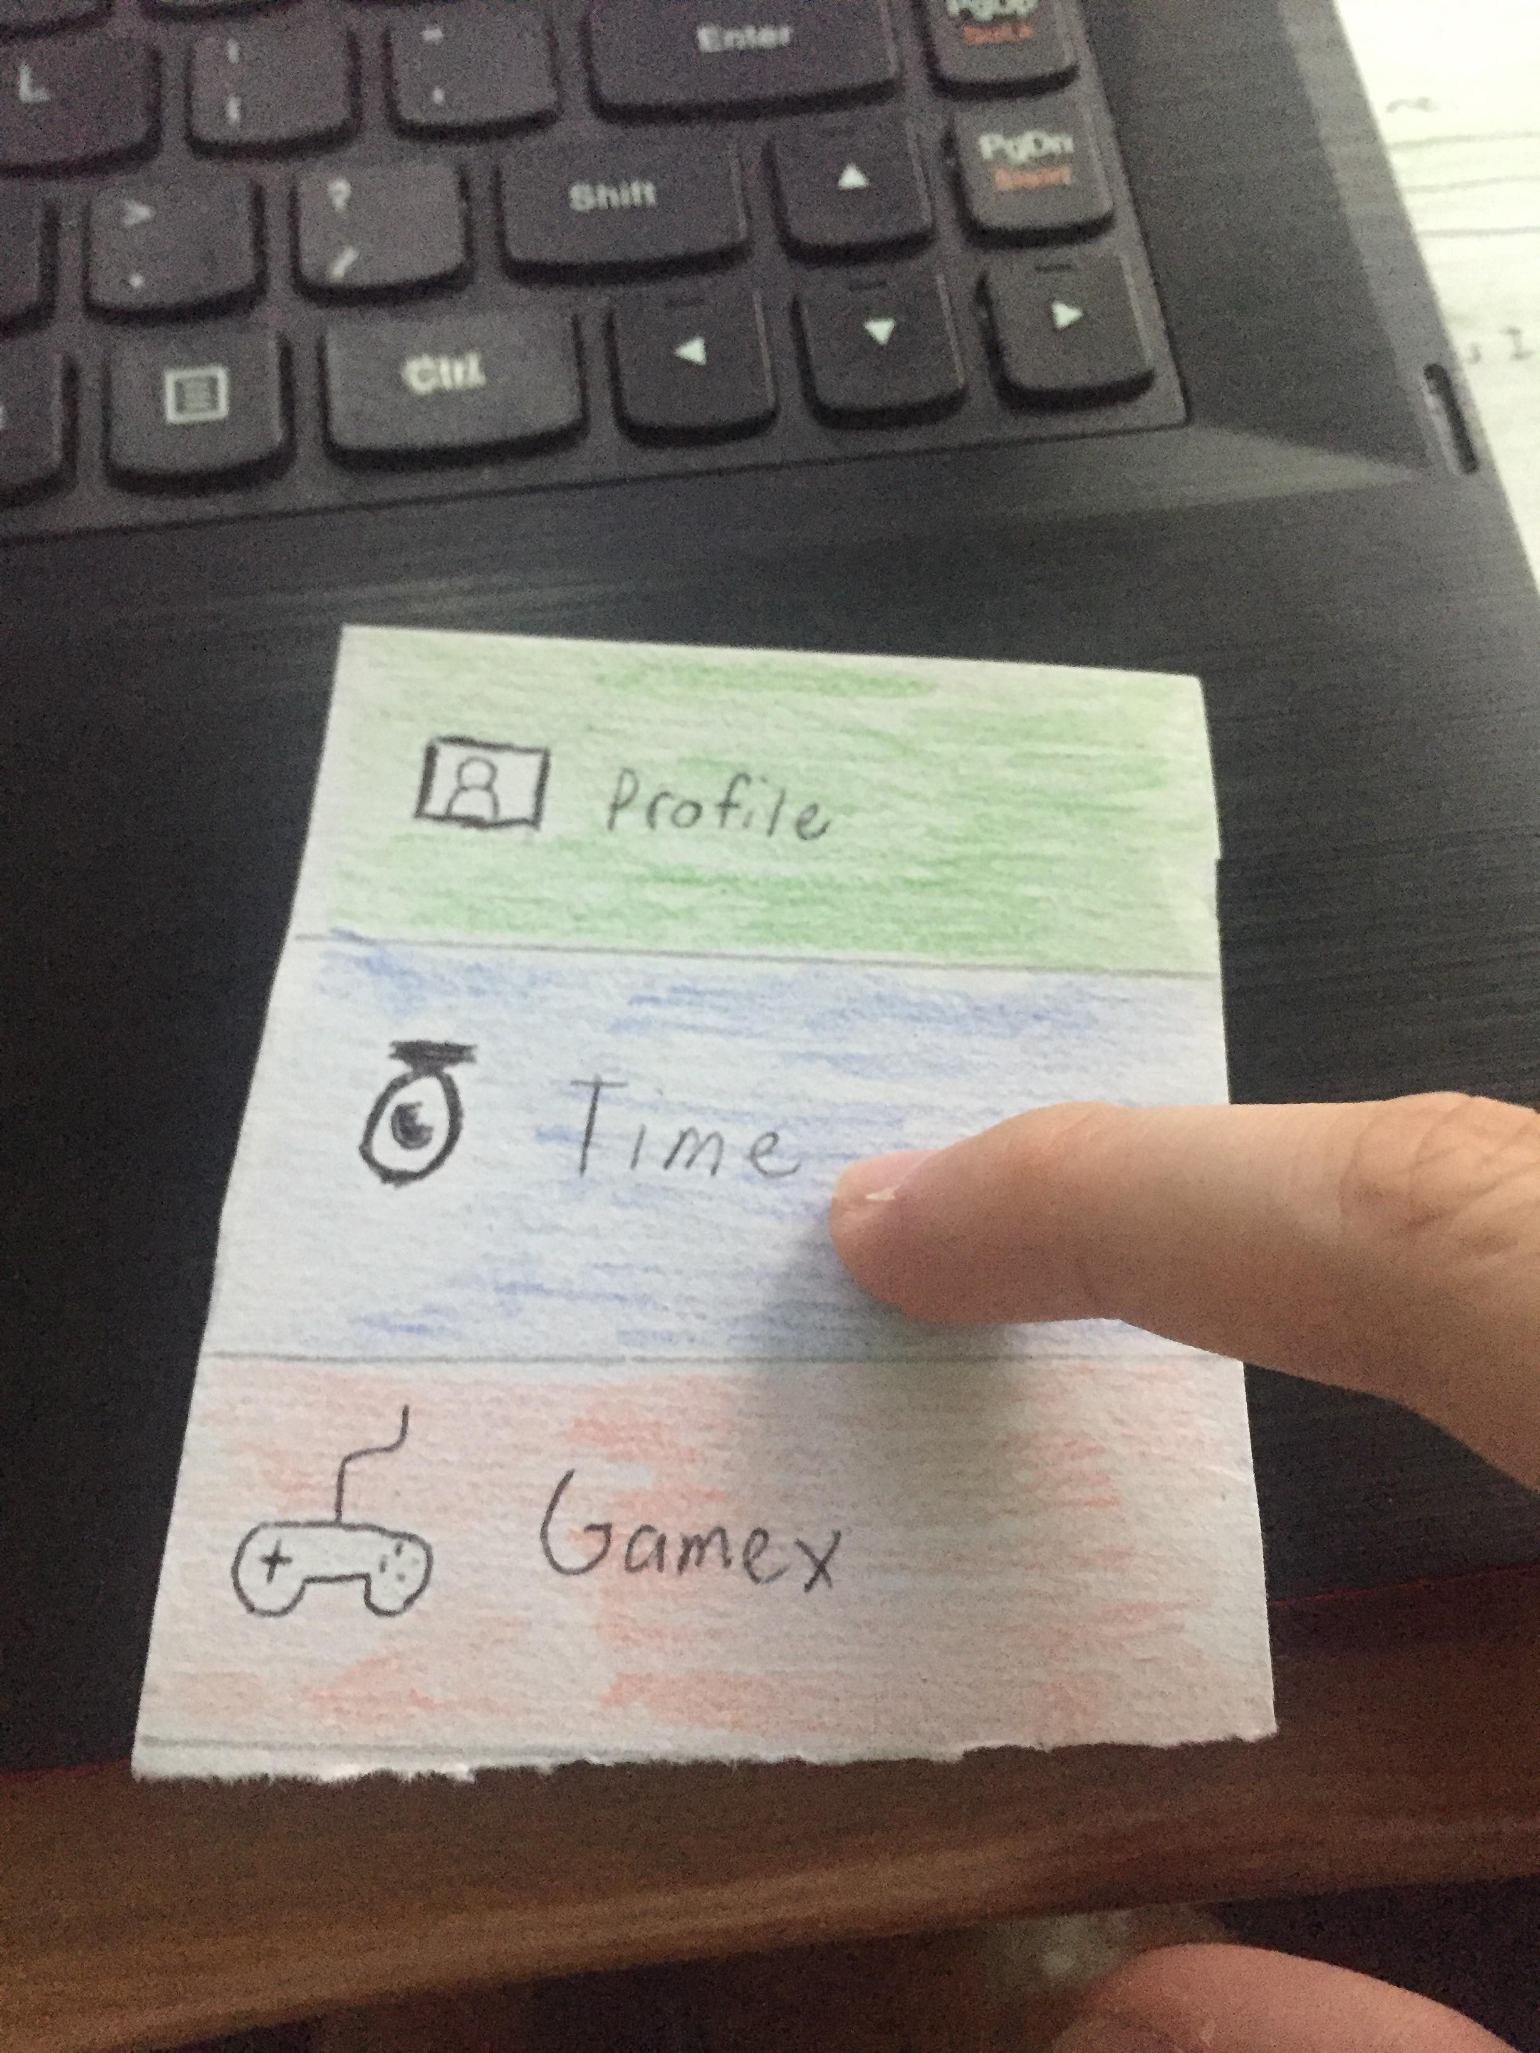
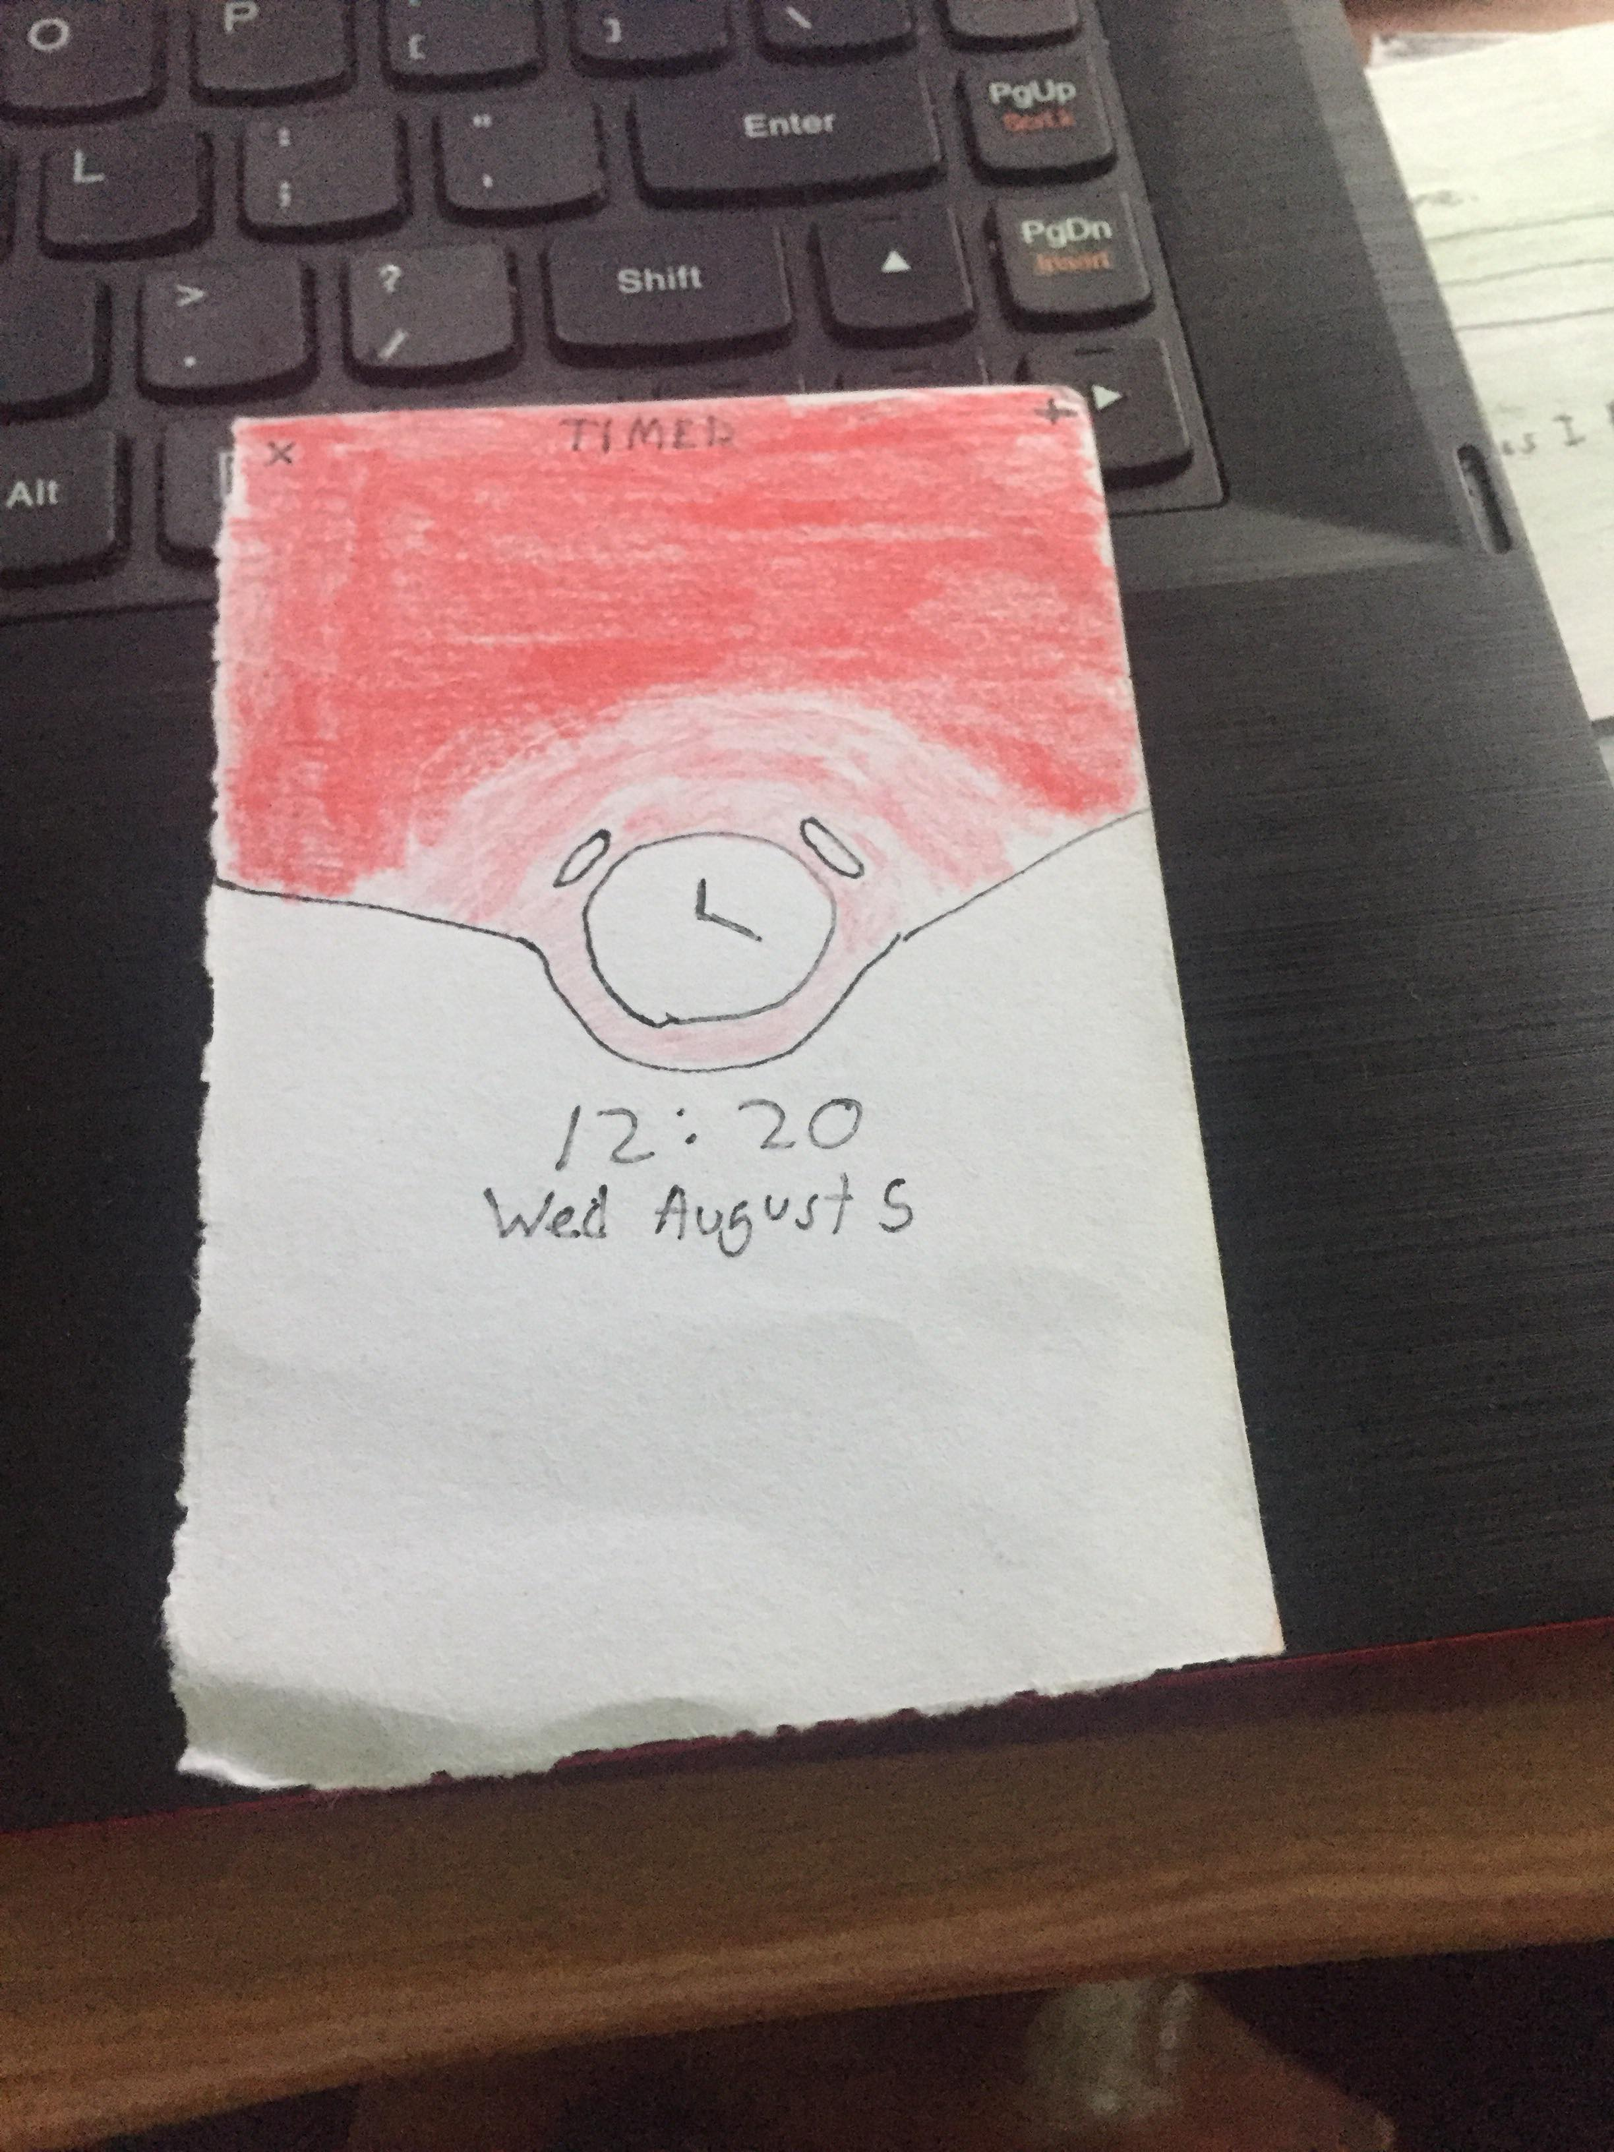
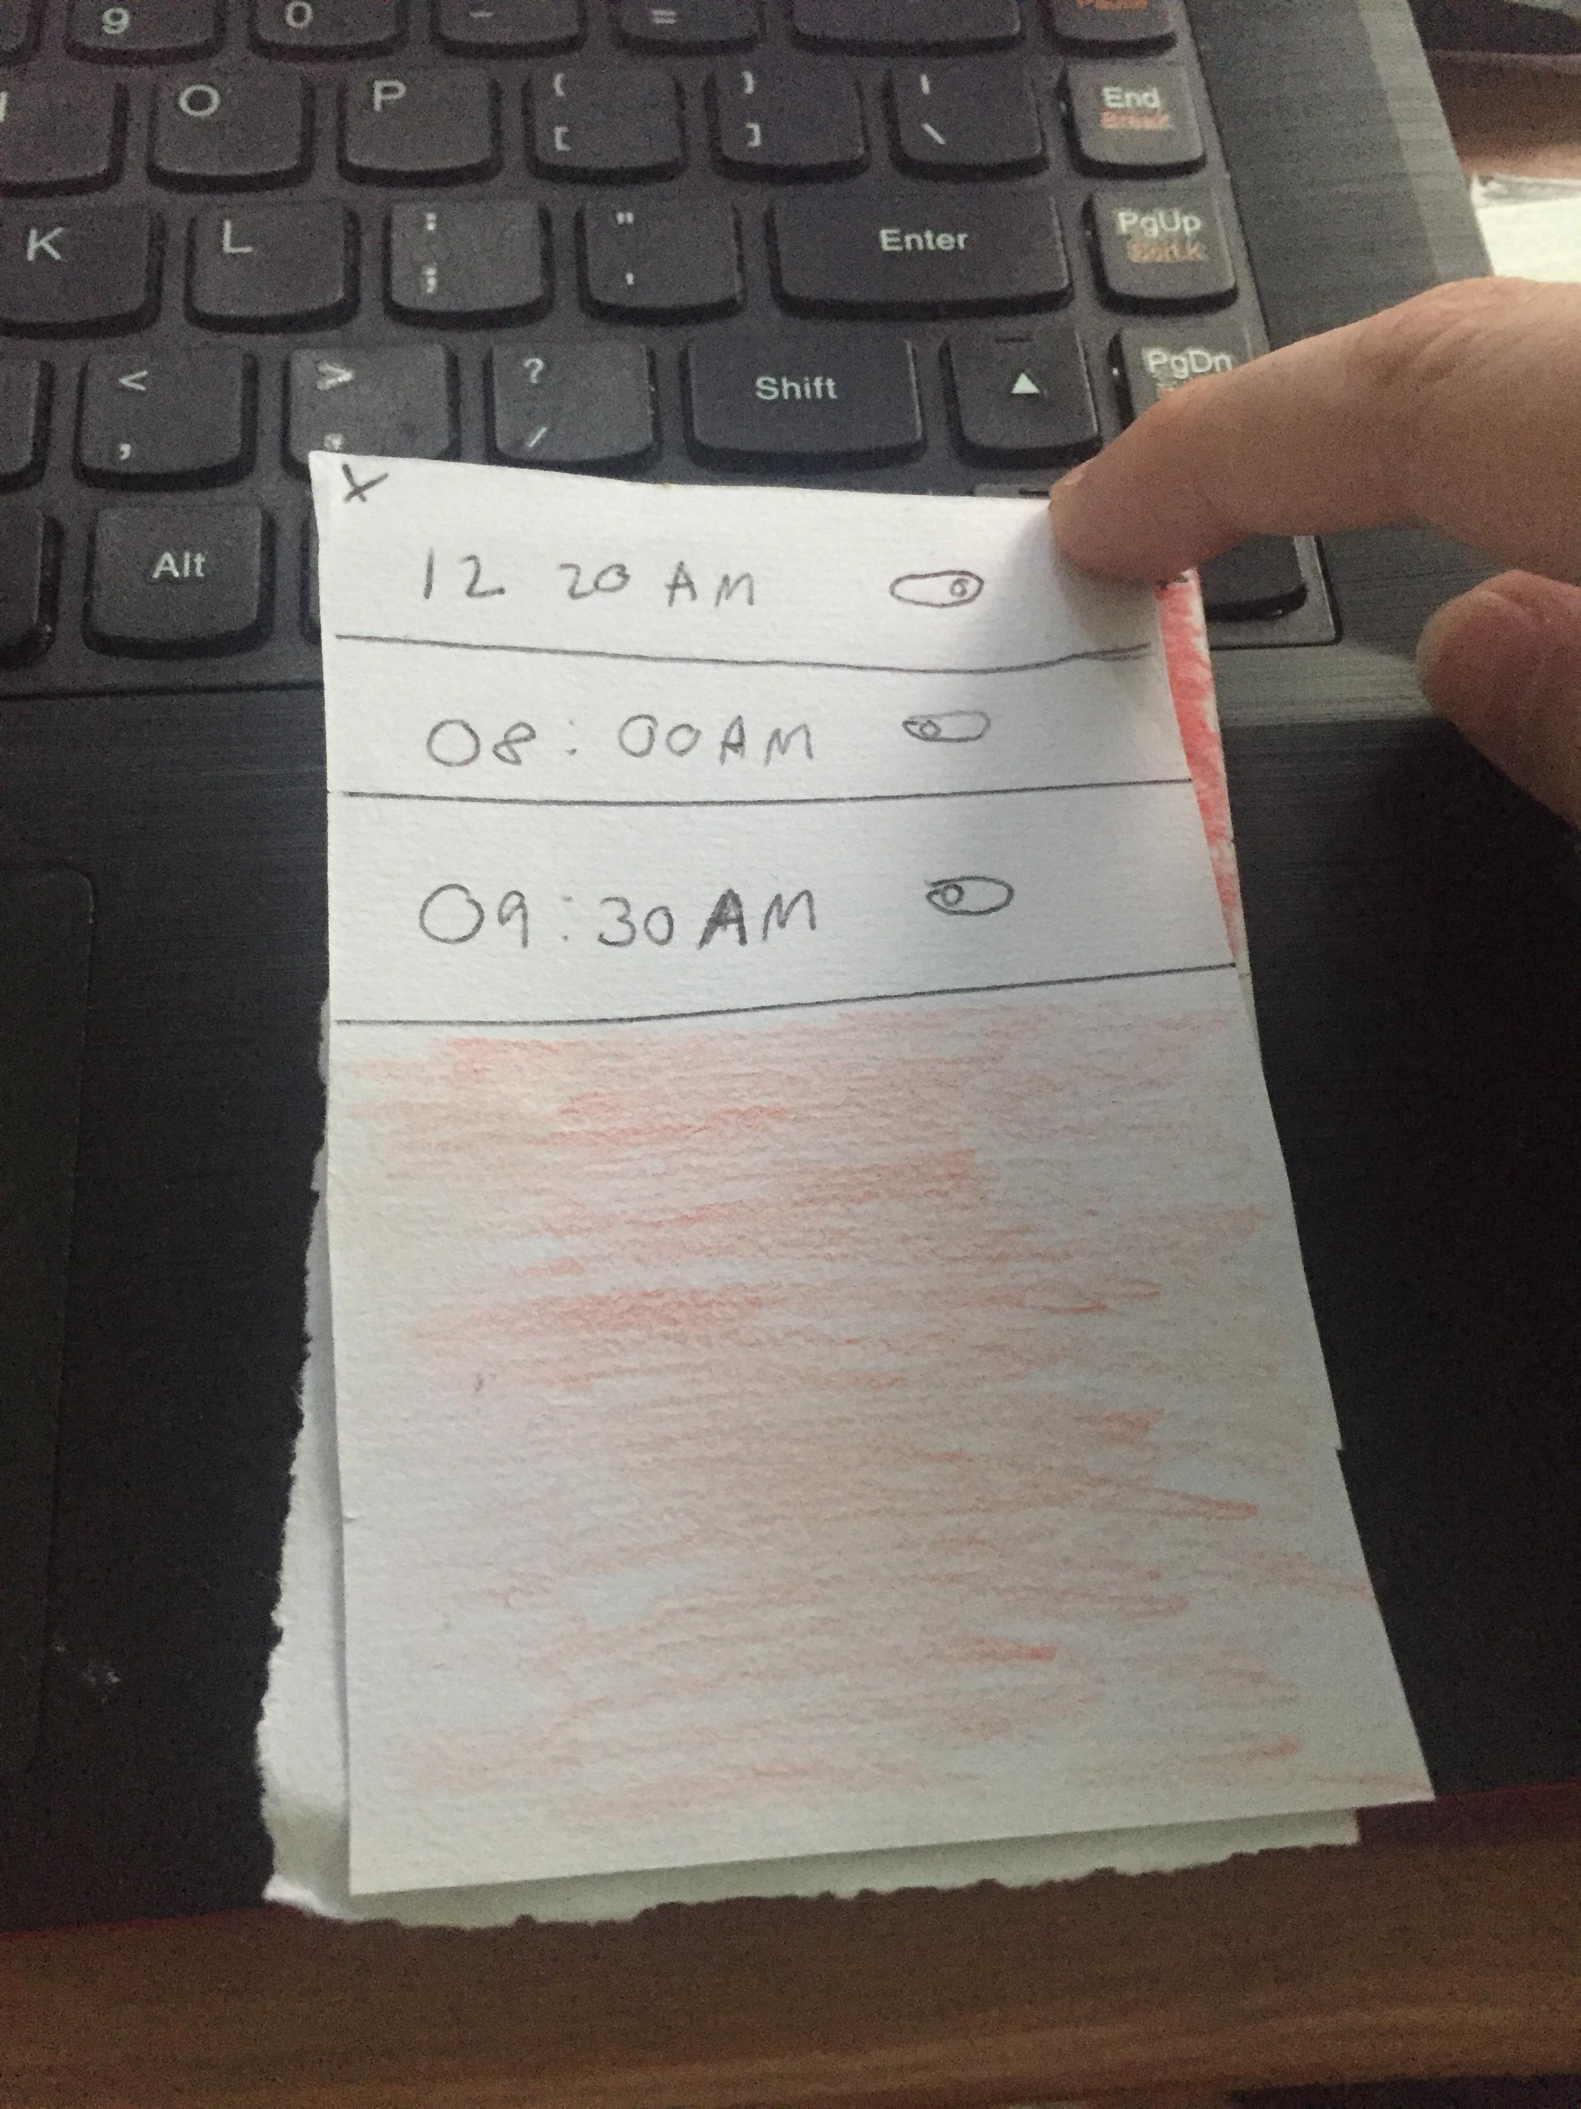
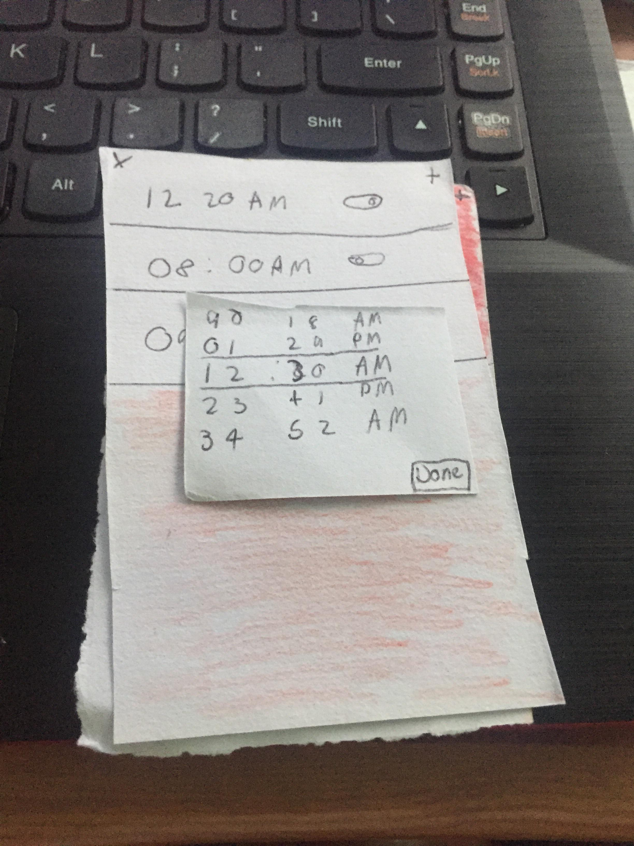
Paper Prototype

Slide 11
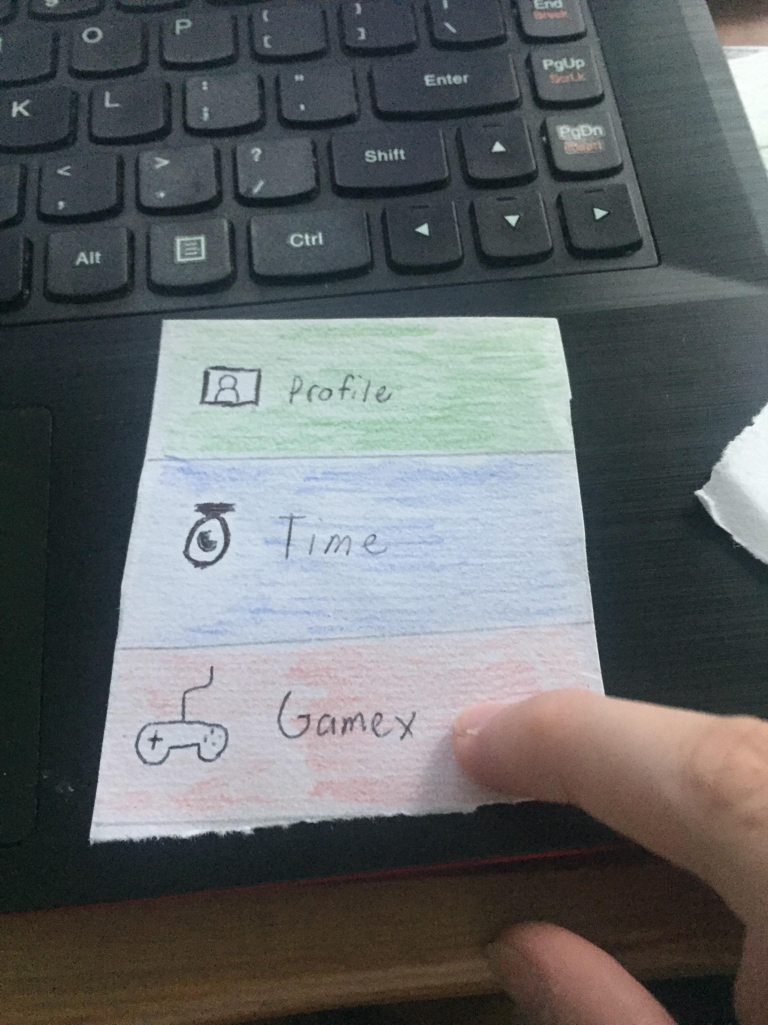
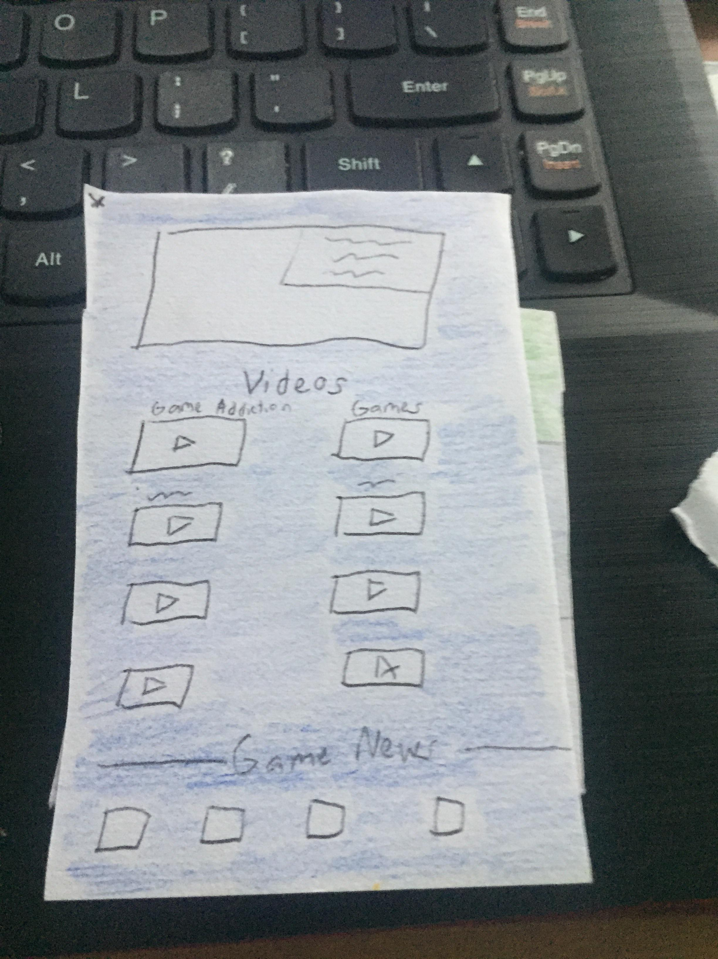
Paper Prototype

Slide 12
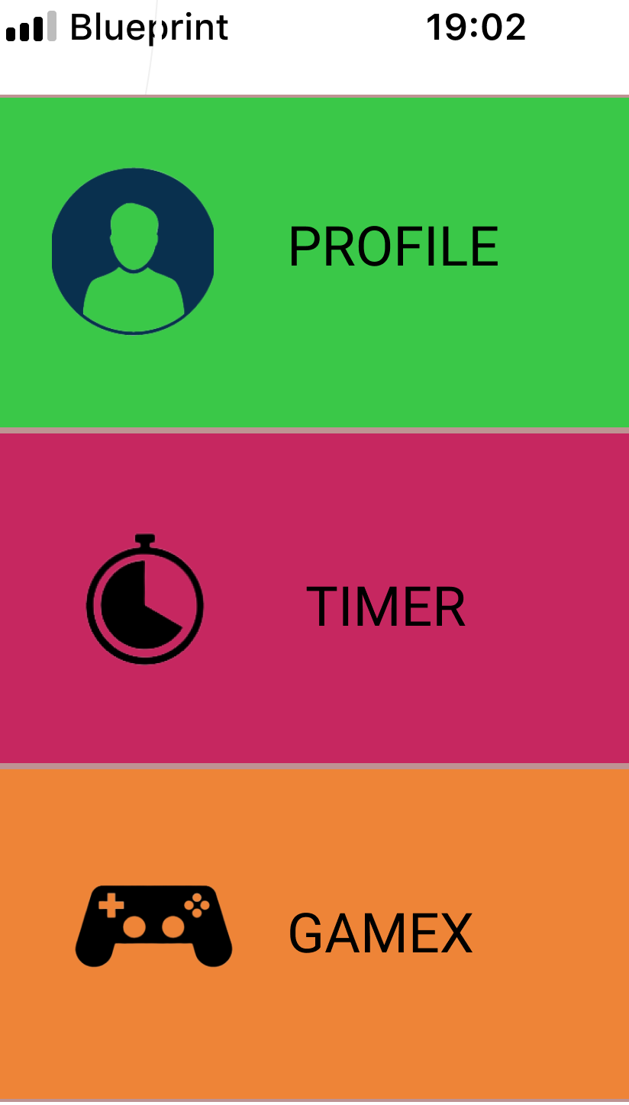
Mock-Up Menu

Slide 13
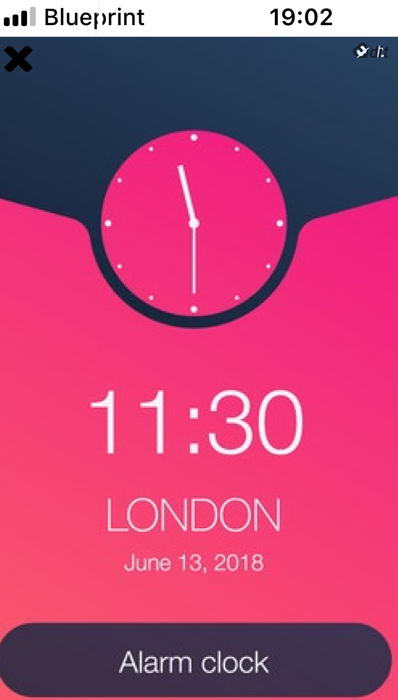
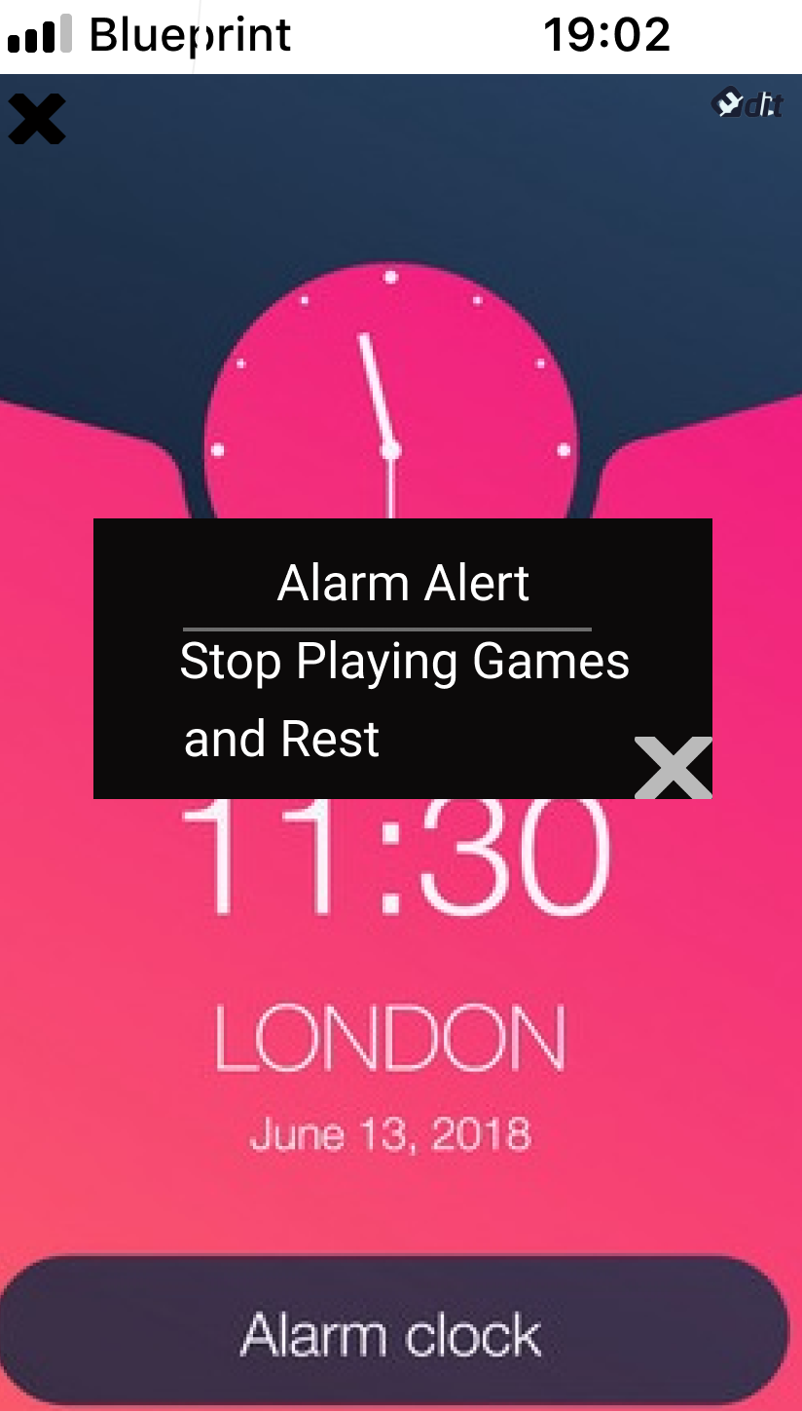
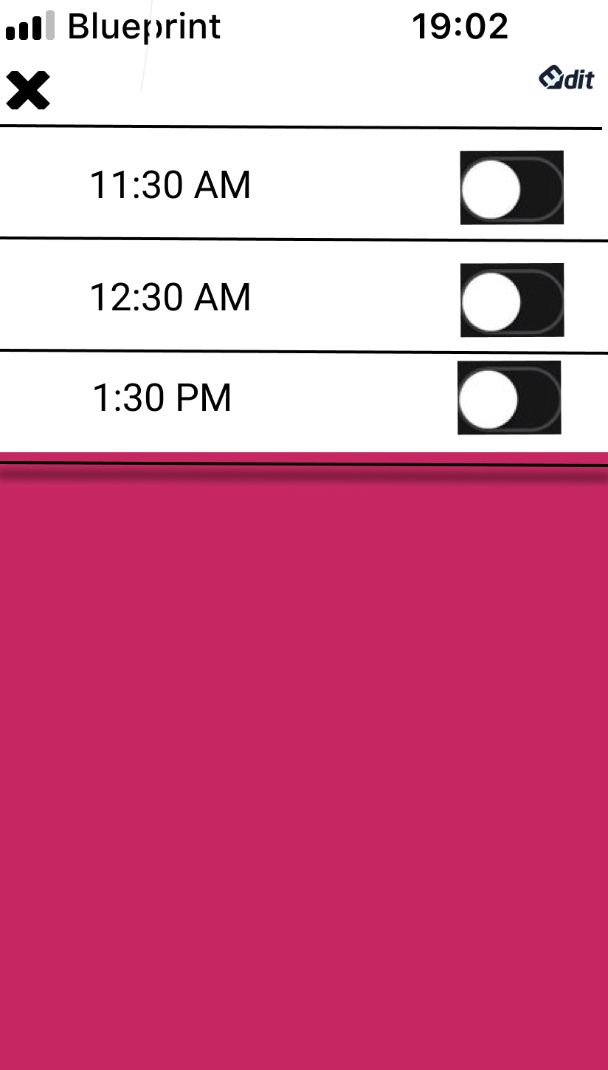
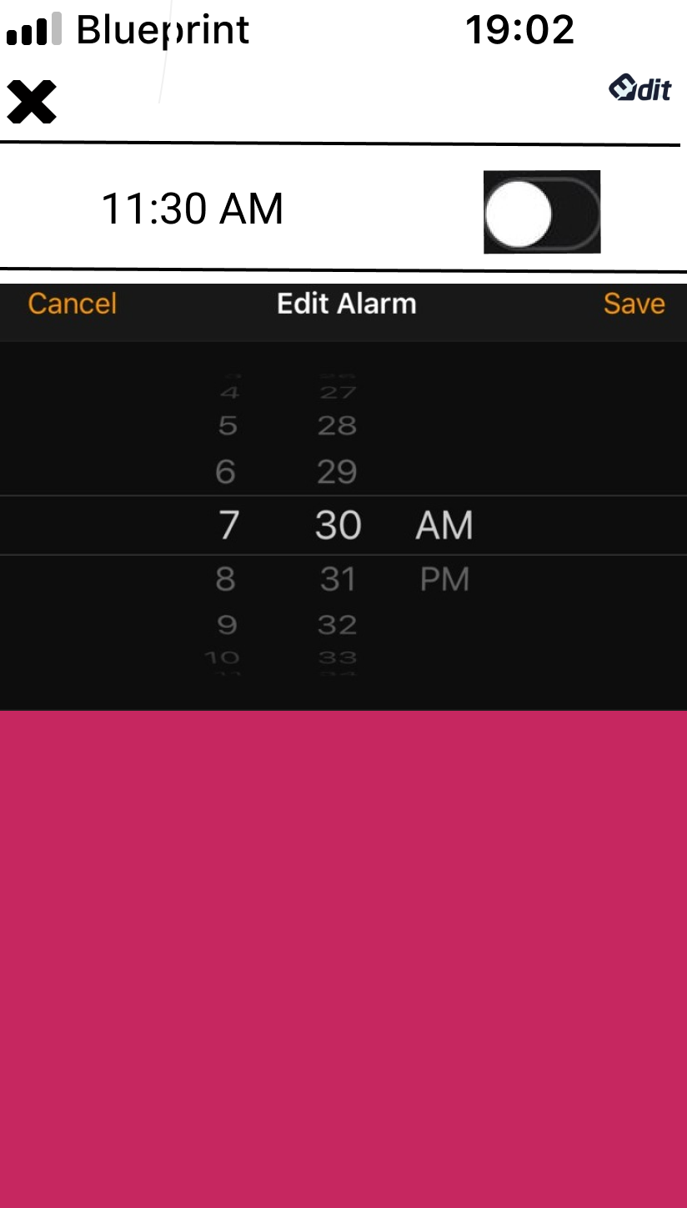
Timer

Slide 14

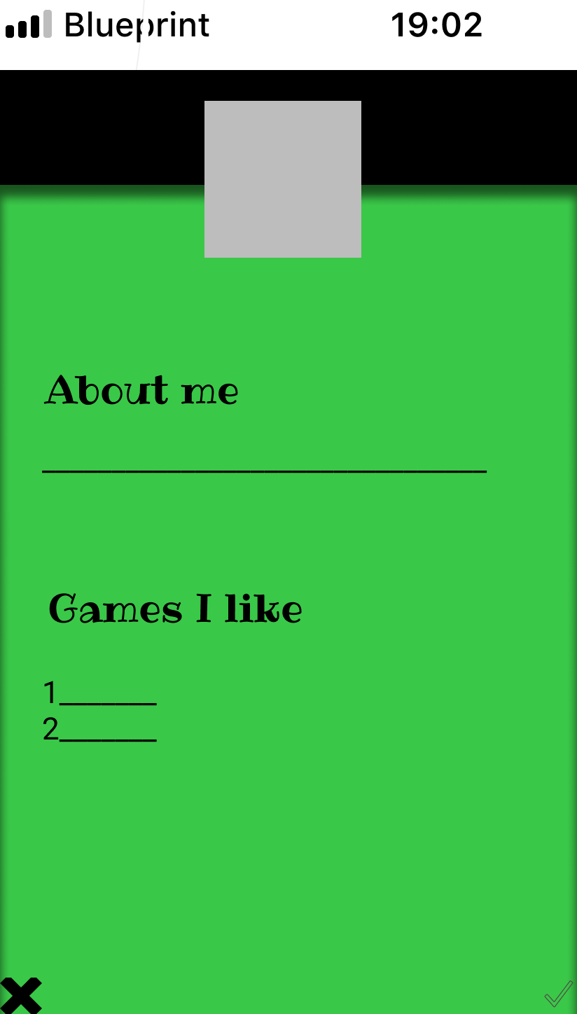
Profile

Slide 15
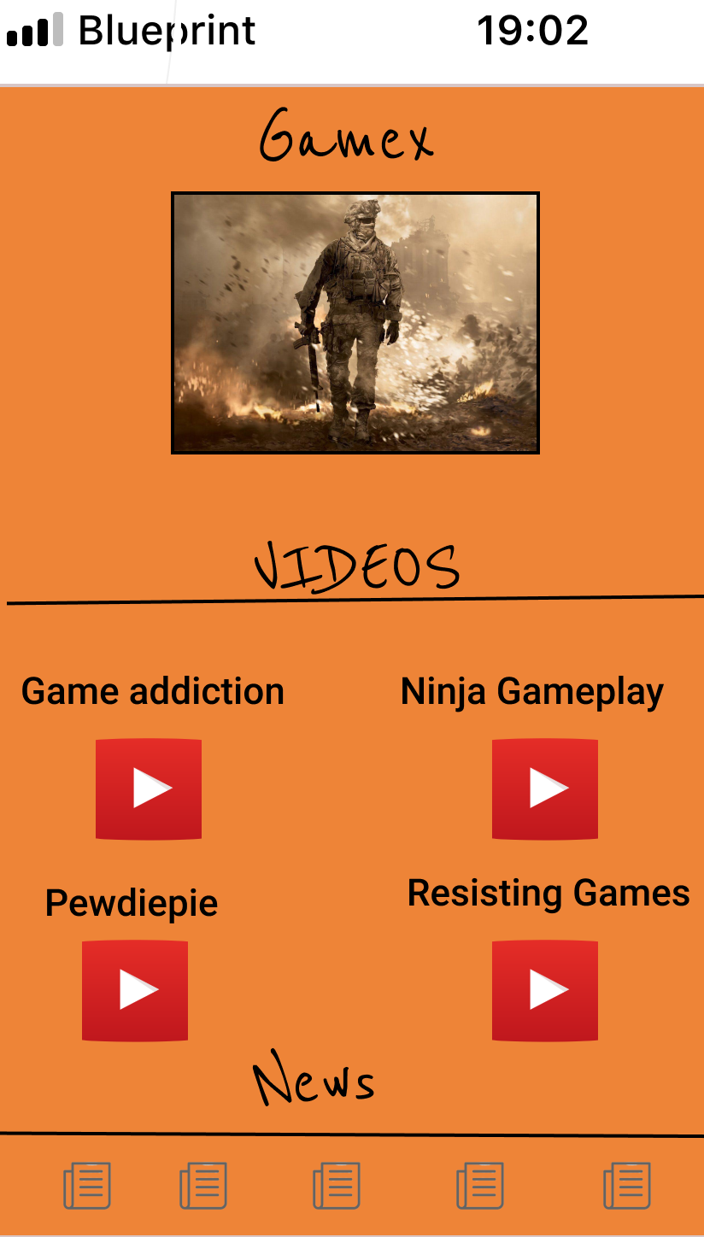
Gamex

Slide 16
Participant’s Feedback
Child
Observation
He liked the color and wants it to be colorful. He said it is cool and gave a thumbs up to me.
Feedback
He liked it and understands it as he is familiar to the app design. I asked if it can help him with game addiction, he said it can.

Slide 17
Participant’s Feedback
Adult
Observation
She said she likes the new design as it is simple and good. She also notice the color fits well and is understandable.
Feedback
She says to add a little more detail to it.

Slide 18
Participant’s Feedback
Teen #1
Observation
He said that he likes it because it is convenient and easy to understand.
Feedback
He liked the color and the reason of the application being made.
Teen #2
Observation
He liked the Gamex screen and think it is a good idea for multiple ages to help stop addiction
Feedback
He suggested maybe add more colors and buttons to the application.

Slide 19
Conclusion

Slide 20
Sources
KAMENETZ, A. (2018). Study: 75% Of Kids Under Age 8 Use Mobile Devices, fastcompany, https://www.fastcompany.com/3020755/study-75-of-kids-under-age-8-use-mobile-devices
ESQUIRE PHILIPPINES (2017). Do Filipino Kids Start Using Mobile Phones Too Young?,esquiremag, https://www.esquiremag.ph/culture/tech/at-what-age-do-filipino-kids-start-using-their-own-mobile-phones-a00207-20171214
“This study also found that 85 percent of all children they surveyed use their mobile phones to access the Internet; and that the Philippines has the highest proportion of children who use tablets and phones, at 76 percent. Suffice it to say that our kids are highly connected.”

